Slide 1
An Introduction DIFFERENCE EQUATIONS
MATHEMATICS II

Slide 2
Topic 1: Difference equations
Objectives:
Find the complementary function of a difference equation.
Find the particular solution of a difference equation.
Analyse the stability of economic systems.
Solve lagged national income determination models.
Solve single-commodity-market models with lagged supply.

Slide 3
Difference equations
Difference equation
A difference equation (sometimes called a recurrence relation) is an equation that relates consecutive terms of a sequence of numbers.
For example, the equation
Y_{t}= 2 Y_{t−1}
In order to determine the sequence uniquely, we need to be given some additional information, such as the ﬁrst term. It is conventional to write the ﬁrst term as Y₀, and once this is given a speciﬁc value all remaining terms are known.
Notes:
Can give example page 553 (2,4,6,8..)

Slide 4
Difference equations
Example:
Write down the ﬁrst four terms of the sequence deﬁned by
Y₀ = 3 and Y_{t}= 2Y_{t−1}
and obtain a formula for the general term Y_{t} in terms of t.

Slide 5
Difference equations
If Y₀ = 3 then
Y₁ = 2Y₀ = 2 × 3 = 6 ;
Y₂ = 2Y₁ = 2 × 6 = 12 ;
Y₃ = 2Y₂ = 2 × 12 = 24
In order to produce a formula for the general term, we write these as
Y₁ = 2Y₀ = 2¹× 3 ; Y₂ = 2Y₁ = 2²× 3 ;Y₃ = 2Y₂ = 2³× 3
It is now obvious from this pattern that the general term, given by
Y_{t}= 3(2^{t})
is the solution of the difference equation
Y_{t}= 2Y_{t−1}
with initial condition
Y₀ = 3

Slide 6
Difference equations
How to find solution of the difference equation?
General equations of the form
Y_{t}= bY_{t−1} + c (*)
The general solution of equation (*) can be written as the sum of two separate expressions known as the complementary function (CF) and the particular solution (PS).
Y_{t}= CF + PS
Notes:
Explain page 555

Slide 7
Difference equations
Complementary function (CF) – Particular solution(PS)
The complementary function is the general solution of the equation when the constant term on the right-hand side is replaced by zero: that is, it is the solution of
Y_{t}= bY_{t−1}
So
CF = A(b^{t})
The particular solution is the name that we give to any solution of equation (*) that we are clever enough to ‘spot’.
Notes:
example 554

Slide 8
Difference equations
Finally, once CF and PS have been found, we can write down the general solution of equation (*) as
Y_{t}= CF + PS = A(b^{t}) + PS
The letter A is no longer equal to the ﬁrst term, Y₀, although it can easily be calculated, as the following example demonstrates.

Slide 9
Difference equations
Example
Solve the following difference equations with the speciﬁed initial conditions.
Comment on the qualitative behavior of the solution in each case.
(a) Y_{t}= 4Y_{t−1} + 21; Y₀ = 1
(b) Y_{t}= (1/3) Y_{t−1} + 8; Y₀ = 2

Slide 10
Difference equations
(a) The difference equation
Y_{t} = 4Y_{t−1} + 21
is of the standard form
Y_{t}= bY_{t−1} + c
and so can be solved using the complementary function and particular solution.
The complementary function is the general solution of the equation when the constant term on the right-hand side is replaced by zero: that is, it is the solution of:
Y_{t}= 4Y_{t−1}
which is A(4^{t}).
Or
CF = A(4^{t})
Notes:
Example 1 page 554 ; can divide this way to step by step for student ;

Slide 11
Difference equations
The particular solution is any solution of the original equation:
Y_{t}= 4Y_{t−1} + 21
that we are able to ﬁnd. In effect, we need to think of a sequence of numbers, Y_{t}, such that when this is substituted into
Y_{t}− 4Y_{t−1}= 21.
Notes:
Can explain

Slide 12
Difference equations
One obvious sequence likely to work is a constant sequence,
Y_{t}= D
for some number, D. If this is substituted into
Y_{t}= 4Y_{t−1} + 21
we obtain
D = 4D + 21
This algebraic equation can be rearranged to get
D =−7
Notes:
Explain more about constant sequence D ; (Note that Y_{t}= D whatever the value of t so Y_{t−1} is also equal to D.)

Slide 13
Difference equations
We have therefore shown that the complementary function is given by
CF = A(4^{t})
and that the particular solution is
PS =−7
Hence
Y_{t}= CF + PS = A(4^{t}) − 7
which is the general solution of the difference equation
Y_{t}= 4Y_{t−1} + 21

Slide 14
Difference equations
To ﬁnd the speciﬁc solution that satisﬁes the initial condition
Y₀ = 1
we simply put t = 0 in the general solution to get
Y₀ = A(4⁰) − 7 = 1
that is,
A − 7 = 1
which gives
A = 8
The solution is
Y_{t}= 8(4^{t}) − 7

Slide 15
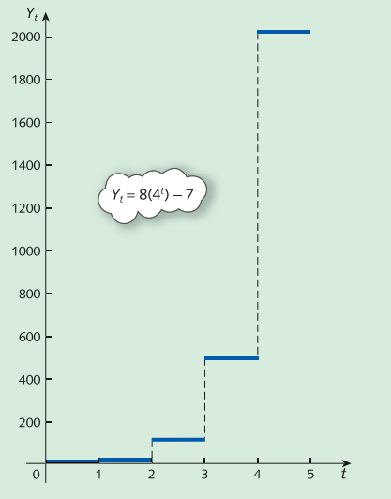
Difference equations
The numbers 4^{t} get ever larger as t increases. We describe this by saying that the time path diverges uniformly or explodes.

Slide 16
Difference equations
We can apply three step to find solution of difference equation:
Y_{t}= bY_{t−1} + c (*)
Step 1 : Find CF
The complementary function is the general solution of the equation when the constant term on the right-hand side is replaced by zero: that is, it is the solution of: Y_{t}= bY_{t−1}
CF = A(b^{t})

Slide 17
Difference equations
Step 2 : Find PS
Put Y_{t}=D and Y_{t-1}=D
With equation (*) we have :
D = bD + c
So we can find D easily and D that mean PS
Step 3: find A
With initial condition Y₀ put it into (*) with t=0 :
Y₀ = A(b⁰) + PS= value of Y₀
we deduce A and we have the solution of difference equation

Slide 18
Difference equations
(b) The difference equation
Y_{t}= (1/3) Y_{t−1} + 8 (*) ; with Y₀=2
Step 1: find CF
The complementary function is given by
CF = A(b^{t}) = A(1/3)^{t}
Step 2 : Find PS
Put Y_{t}=D and Y_{t-1}=D
With equation (*) we have :
D = (1/3) D + 8
So we can find D easily and D that mean PS
D = PS = 12
The general solution is therefore
Y_{t}= CF + PS = A(1/3)^{t}+ 12

Slide 19
Difference equations
Step 3: find A
With initial condition Y₀ = 2 put it into (*) with t=0
Y₀ = A(1/3)⁰ + 12 = 2
Or
A + 12=2
and so A is −10. The solution of difference equation is
Y_{t}=−10(1/3)^{t}+ 12

Slide 20
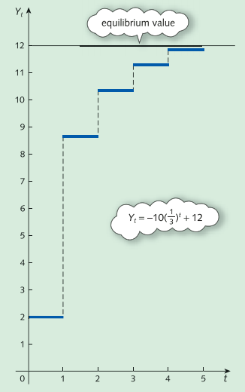
Difference equations
The numbers (1/3)^{t} get ever smaller as t increases. We describe this by saying that the time path converges uniformly to the value of 12 , which is referred to as the equilibrium value

Slide 21
Difference equations
Summary
The results of the previous example and Practice Problem 2 can be summarized:
If b > 1 then Y_{t} displays uniform divergence.
If 0 < b < 1 then Y_{t} displays uniform convergence.
If −1 < b < 0 then Y_{t} displays oscillatory convergence.
If b < −1 then Y_{t} displays oscillatory divergence.
Notes:
More case in book page 559

Slide 22
Difference equations
National income determination
The corresponding consumption function is given by
C_{t}= aY_{t−1} + b
If we assume that investment is the same in all time periods then
I_{t}= I*
for some constant, I*. Finally, if the ﬂow of money is in balance in each time period, we also have
Y_{t}= C_{t}+ I_{t}
Substituting the expressions for C_{t} and I_{t} into this gives
Y_{t}= aY_{t−1} + b + I*
Notes:
Explain more about t and t -1 / page 559

Slide 23
Difference equations
Example
Consider a two-sector model:
Y_{t}= C_{t}+ I_{t}
C_{t}= 0.8Y_{t−1} + 100
I_{t}= 200
Find an expression for Y_{t} when Y₀ = 1700.
Is this system stable or unstable?

Slide 24
Difference equations
Substituting the expressions for C_{t} and I_{t} into
Y_{t} = C_{t}+ I_{t}
gives
Y_{t}= (0.8Y_{t−1} + 100) + 200
= 0.8Y_{t−1} + 300 (*)
Step 1: find CF
The complementary function is given by
CF = A(b^{t}) = A(0.8)^{t}

Slide 25
Difference equations
Step 2 : Find PS
Put Y_{t}= D and Y_{t-1}=D
With equation (*) we have :
D = (0.8) D + 300
So we can find D easily and D that mean PS
D = PS = 1500
The general solution is therefore
Y_{t}= CF + PS = A(0.8)^{t} + 1500

Slide 26
Difference equations
Step 3: find A
With initial condition Y₀ = 1700 put it into (*) with t=0
Y₀ = A(0.8)⁰ + 1500 = 1700
Or
A + 1500 = 1700
and so A is 200. The solution of difference equation is
Y_{t} =200(0.8)^{t}+ 1500

Slide 27
Difference equations
As t increases, (0.8)^{t} converges to zero and so Y_{t} eventually settles down at the equilibrium level of 1500. The system is therefore stable.
Note also that because 0 < 0.8 <1, the time path displays uniform convergence.

Slide 28
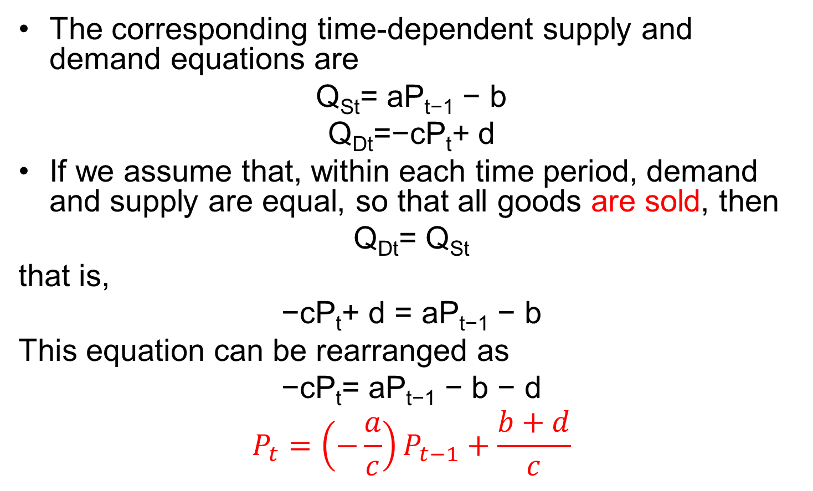
Difference equations
Supply and demand analysis
The corresponding time-dependent supply and demand equations are
Q_{St}= aP_{t−1} − b
Q_{Dt}=−cP_{t}+ d
If we assume that, within each time period, demand and supply are equal, so that all goods are sold, then
Q_{Dt}= Q_{St}
that is,
−cP_{t}+ d = aP_{t−1} − b
This equation can be rearranged as
−cP_{t}= aP_{t−1} − b − d
$$P_{t}=\left(−\frac{a}{c}\right)P_{t−1}+\frac{b+d}{c}$$
Notes:
Explain page 561 , lagged time

Slide 29
Difference equations
Example
Consider the supply and demand equations
Q_{St}= 4P_{t−1} − 10
Q_{Dt}=−5P_{t}+ 35
Assuming that the market is in equilibrium, ﬁnd expressions for P_{t} and Q_{t} when P₀ = 6.
Is the system stable or unstable?

Slide 30
Difference equations
If
Q_{Dt}= Q_{St}
then
−5P_{t}+ 35 = 4P_{t−1} − 10
which rearranges to give
−5P_{t} = 4P_{t−1} − 45
P_{t}=−0.8P_{t−1} + 9 (*)
Step 1: find CF
The complementary function is given by
CF = A(b^{t}) = A(-0.8)^{t}

Slide 31
Difference equations
Step 2 : Find PS
Put P_{t}= D and P_{t-1}=D
With equation (*) we have :
D = (- 0.8) D + 9
So we can find D easily and D that mean PS
D = PS = 5
The general solution is therefore
P_{t}= CF + PS = A(-0.8)^{t} + 5

Slide 32
Difference equations
Step 3: find A
With initial condition P₀ = 6 put it into (*) with t=0
P₀ = A(-0.8)⁰ + 5 = 6
Or
A + 5 = 6
and so A is 1. The solution of difference equation is
P_{t} = (-0.8)^{t}+ 5

Slide 33
Difference equations
An expression for Q_{t} can be found by substituting this into the demand equation
Q_{t}=−5P_{t}+ 35
to get
Q_{t}=−5 [(−0.8)^{t} + 5] + 35 =−5(−0.8)^{t}+ 10
As t increases, (−0.8)^{t} converges to zero and so P_{t} and Q_{t} eventually settle down at the equilibrium levels of 5 and 10 respectively. The system is therefore stable.
Note also that because -1< −0.8 <0, the time paths display oscillatory convergence.
Notes:
Explain more . Some note in page 563 about Pt

